Slide 1


High Performance Cluster Computing
Architectures and Systems
Hai Jin
Internet and Cluster Computing Center

Slide 2
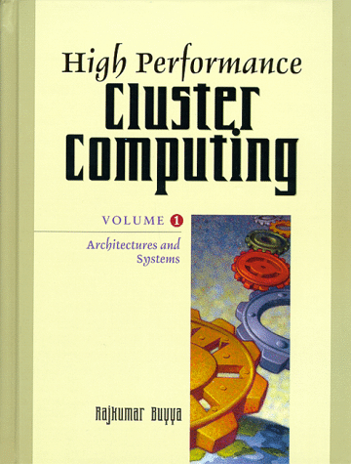
Deploying a High Throughput Computing Cluster
Introduction
Condor Overview
Software Development
System Administration
Summary

Slide 3
Introduction (1)
HTC(High Throughput Computing) environment
  To provide large amounts of processing capacity to customers over long periods of time by exploiting existing computing resources on the network
  To maximize processing capacity
    Must utilize heterogeneous resources
    Required a portable solution that encapsulates the differences between resources
      Include resource management framework
  To provide capacity over long periods of time
    The environment must be reliable and maintainable
    Surviving software and hardware failure
    Allowing resources to join and leave the cluster easily
    Enabling system upgrade and reconfiguration without significant downtime

Slide 4
Introduction (2)
HTC software must be robust and feature-rich to meet the needs of resource owners, customers, system administrators
  Resource owners
    Must be satisfied that their rights will be respected and the policies they specify will be enforced
    To donate the use of their resources to the customers
  Customers
    Only if the cost of learning the complexities of the HTC system is not outweighed the benefit of additional processing capacity
    Will use the HTC environment to run their applications
  System administrators
    Only if system provides a tangible benefit to its users which outweighs the cost of maintaining
    Will install and maintain the system

Slide 5
Introduction (3)
Resources in the HTC cluster may be distributive owned
  Control over powerful computing resources in the cluster is distributed among many individuals and small groups
The willingness to share a resource with the HTC environment may vary for each resource owner
  The cluster may include some resources which are dedicated to HTC, others which are unavailable for HTC during certain hours or when the resource is otherwise in use, and still others which are available to specific HTC customers and applications
  Even when resources are available for HTC, the application may be allowed only limited access to the components of the resource and may be preempted at any time
  Distributed ownership often results in decentralized maintenance, when resource owners maintain and configure each resource for a specific use
  This adds an additional degree of resource heterogeneity to the cluster

Slide 6
Introduction (4)
Describes some of the challenges faced by software developers and system administrators when deploying an HTC cluster, and some of the approaches for meeting those challenges
  Usability
  Flexibility
  Reliability
  Maintainability

Slide 7
Condor Overview
Condor example
  Customer agent
    Represent customer
    Manages a queue of application descriptions
    Sends resource request to the matchmaker
  Resource agent
    Represent resource
    Implements the policies of the resource owner
    Sends resource offers to the matchmaker
  Matchmaker
    Responsible for finding matches between resource requests and resource offers
    Notifying the agents when a match found

Slide 8
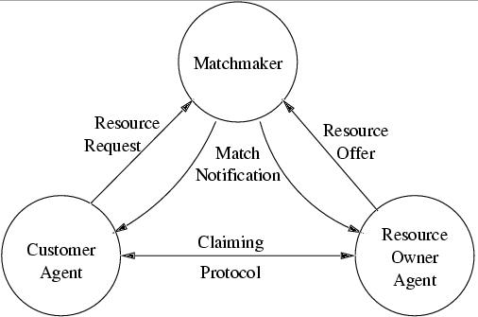
Condor Resource Management Architecture

Slide 9
Condor overview (Cont’d)
Condor example (cont’d)
  Upon notification, the customer agent and the resource agent perform a claiming protocol to initiate the allocation
  Resource requests and offers contain constraints which specify if a match is acceptable
  Matchmaker implements system wide policies by imposing its own set of constraints on matches

Slide 10
Software Development
Developer of HTC system must overcome four primary challenges
  Utilization of heterogeneous resources
    Requires system portability
    Portability obtained through a layered system design
  Evolution of network protocols
    Required for a system where resources and customer needs are constantly changing
    Requiring deployment of new features in the HTC system
  Remote file access mechanism
    Guarantees that an application will be able to access its data files from any workstation in the cluster
  Utilization of non-dedicated resources
    Requires the ability to preempt and resume an application using a checkpoint mechanism

Slide 11
Layered Software Architecture (1)
HTC system relies on the host OS to provide network communication, process management, workstation statistics
  Since the interface to the services differs on each OS, the portability of the HTC system will benefit from a layered software architecture
  The system is written to a system independent API, reducing the cost of porting to a new architecture

Slide 12
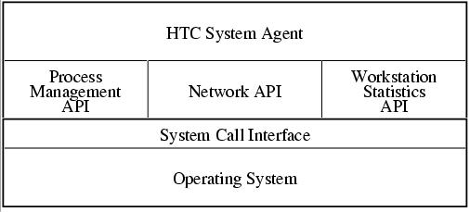
Layered Software Architecture (2)

Slide 13
Layered Software Architecture (3)
Network API
  Provide connection-oriented and connectionless, reliable and unreliable interfaces, with many mechanisms for authentication and encryption
  Perform all conversions between host and network integer byte order automatically
  Check for overflows
  Provide standard host address lookup mechanisms

Slide 14
Layered Software Architecture (4)
Process management API
  Provides the ability to create, suspend, unsuspend and kill a process to enable the HTC system to control the execution of a customer’s application
  Parent process may pass state to new child processes, including network connections, open files, environment variables, security attributes
    Child process may not run an instance of the same API

Slide 15
Layered Software Architecture (5)
Workstation statistics API
  Reports the information necessary to implement the resource owner policies and verify that the customer application requirements are met
Standard libraries
  Advantage
    Save time in developing HTC system
    Better tested
  Disadvantage
    May be poor fit for specific HTC system
    May not be a available for all platforms
    May work incorrectly on some platforms

Slide 16
Layered Resource Management Architecture (1)
Resource management architecture of the HTC environment also benefits from a layered system design framework
  Layered system design in Condor
    Yields a modular system design
    The interface to each system layer is defined in the resource management model
    The interface allowing the implementation of each layer to change so long as the interface continues to be supported
    Separates the advertising, matchmaking, and claiming protocols

Slide 17
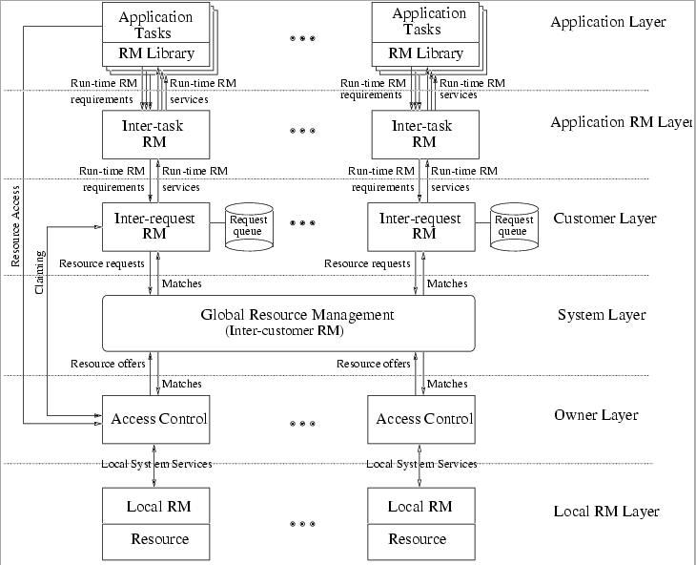
Layered Resource Management Architecture (2)

Slide 18
Protocol Flexibility
As the distributed system evolves to provide new and improved services, the network protocols will be affected
  Protocols are augmented to transfer additional information
    Requires that all components of the distributed system updated to recognize the additional information
    In large HTC system, it is often inconvenient to update all components at one time
  To support the evolution, the HTC network protocols may utilize a general purpose data format which allows more flexibility
    Example : Condor protocol -> Similar RPC protocol
    Leading integer specify action, named parameter list associate with action
    Provide backward compatibility, since older agents will ignore the new parameters and new agents are written to accept packets with or without the new parameters

Slide 19
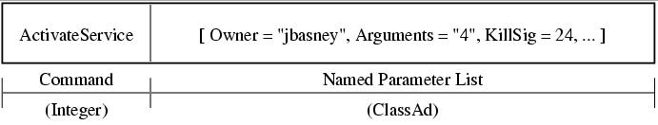
Example of Protocol Data Format

Slide 20
Remote File Access (1)
A remote file access mechanism guarantees that an HTC application will have access to its data files from any workstation in the cluster
To use an existing distributed file system
  The HTC environment must authenticate the customer’s application to that file system
    NFS authenticates via user ID
    AFS and NTFS authenticate via Kerberos and NT server credentials
  To run the customer’s application, the HTC environment may require administrator privileges on the remote workstation, ability to transparently forward credential (using the customer’s password)
  The customer may be required to grant file access permission to the HTC system before submitting the application for execution

Slide 21
Remote File Access (2)
To implement data file staging
  The system transfers input files to the local disk of the remote workstation before running the application
  The system is responsible for gathering up the application’s output files and transferring them to a destination specified by the customer
  Requires free disk space on the remote workstation and the bandwidth to transfer the data files at the start and end of each allocation
  For large data files, results in high start-up and tear-down costs compared to a block file access mechanism provided by distributed file system or redirect file I/O system calls

Slide 22
Remote File Access (3)
Redirecting file I/O system calls
  HTC environment must interpose itself between application and OS and service file I/O system calls itself
  Accomplished by linking the application with an interposition library or by trapping system call through OS interface
  Has the significant benefit that it places no file system requirement on the remote workstation
  Enables the HTC environment to utilize a greater number of resources
  Drawback is developing and maintaining a portable interposition system can be very difficult, since different OS provide different interposition techniques and the system call interface differs on each OS and often change with each new OS release

Slide 23
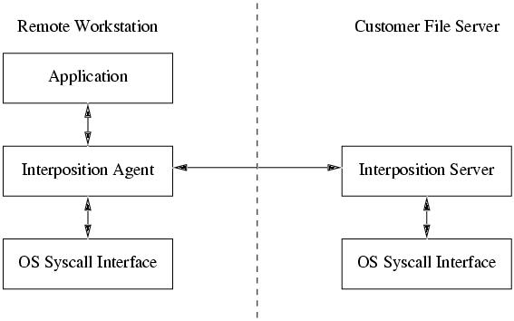
System Call Interposition

Slide 24
Checkpointing
Checkpoint of an executing program is a snapshot of its state which can be used to restart the program from that state at a later time
  Provide reliability
    When a compute node fails, the program running on that node can be restarted from its most recent checkpoint
  Enables preemptive-resume scheduling
    All parties involved in an allocation can break the allocation at any time without losing the work already accomplished by simply checkpointing the application
  Most workstation OS do not provide kernel-level checkpointing service
    HTC environment must often rely on user-level checkpointing
    Developing a portable, user-level checkpointing is a significant challenge, since OS APIs for querying and setting process state vary and are often incomplete

Slide 25
System Administration
Administrator of an HTC environment answer to resource owners, customers, policy makers
  Have responsibility to guarantee that the HTC environment enforces the access policies of resource owners
    Since resources in a cluster are often heterogeneous and distributive owned, these policies are often complicated and vary from resource to resource
  Have responsibility for ensuring that customers receive valuable service from the HTC environment
    Involves working with customers to understand the needs and development of their applications, detect application failures, investigate the causes of the failures, develop solutions to avoid future failures
  Must demonstrate to policy makers that the HTC environment is meeting stated goals
    Requires accounting of system usage and availability

Slide 26
Access Policies
Resource access policy specifies who may use a resource, how they may use it, and when they may use it
Administrator determines an access policy in consultation with the resource owner and implement
  Define a set of expressions which specify when an application may begin using a resource and when and how an application must stop using a resource
    Requirements
    Rank (preference of resource owner)
    Suspend
    Continue
    Vacate
    Kill

Slide 27
Examples
  Requirements = (keyboardIdle > 15 * Minute) && (LoadAvg < 0.3)
  Rank = (Customer == jbasney@cs.wisc.edu) ? 1 : 0
  Suspend = (KeyboardIdle < Minute)
  Continue = (KeyboardIdle > 2 * Minute)
  Vacate = (SuspendTime > 5 * Minute)
  Kill = (VacateTime > 5 * Minute)
  Vacate = (SuspendTime > 5 * Minute) && (JobImageSize < 100*MB)
  Kill = (JobImageSize < 100*MB) ? (VacateTime > 5 * Minute) : (SuspendTime > 5 * Minute)

Slide 28
Reliability (1)
Reliability is a primary concern in an HTC environment
  Distributed file system can be a frequent cause of system failure
    File system failure may cause process crash due to page faults
    HTC software must react when configuration files and log files are temporarily inaccessible
  HTC system is responsible for enforcing the policies of the resource owner
    The system processes don’t fail and leave running application unattended
    A master process
      Monitor the other HTC processes to detect failures and invoke recovery mechanism
      Cache executable files on the local disk
      Serve as an administrative module (gathering statistics)
        Report currently running services
        Allow the administrator to start and stop services
        Detect and react to configuration changes and system upgrade

Slide 29
Reliability (2)
HTC environment must be prepared for failures and must automate failure recovery for common failures
  HTC software must be able to distinguish between normal and abnormal termination of application
    Abnormal termination due to an environmental failure or unrecoverable application error
  One approach is monitor the system calls to detect source of failure
  System could defer to the customer, asking the customer to alert the system when application terminates abnormally

Slide 30
Problem Diagnosis via System Logs
System log files are the primary tools for diagnosing system failures
  Using log files, the administrator should be able to reconstruct the events leading up to the failure
  Need to manage the amount of historical log information
  Managing distributed log file
    Store logs centrally on a file server or a customized log server
    To provide a single interface to the distributed log files by installing logging agents on each workstation which will respond to log queries made by a client application

Slide 31
HTC Environment Logs
Application log | System call trace Checkpointing information and statistics Remote I/O trace with statistics Errors occurring during the allocation
Customer log | Allocation information and statistics Application arrival and termination Matchmaking and claiming errors
Resource log | Allocation information and statistics Policy action trace
Master log | HTC agent (re-)starts Administrative commands Agent upgrades
Scheduling log | Record of all matches Allocation history (accounting)
Security log | Record of all rejected requests Record of all authenticated actions

Slide 32
Monitoring and Accounting
HTC environment provides system monitoring and accounting facilities to the administrator
  Allow the administrator to assess the current and historical state of the system and to track system usage

Slide 33
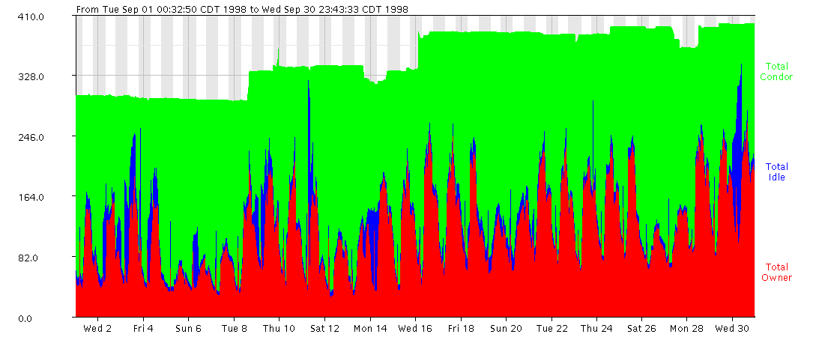
Monitoring Resource Usage

Slide 34
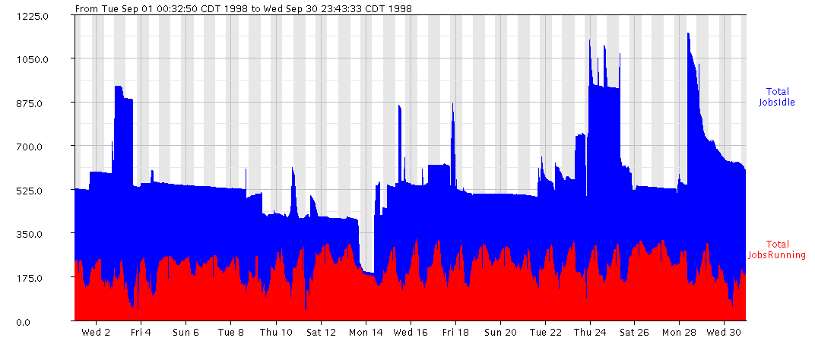
Monitoring HTC Applications

Slide 35
Security (1)
HTC environment is potentially vulnerable to both resource and customer attacks
  A resource attack
    Occurs when an unauthorized user gains access to a resources via the HTC environment
    When an authorized user violates the resource owner’s access policy
  A customer attack
    Occurs when the customer’s account or data files are compromised via the HTC environment

Slide 36
Security (2)
Protecting the resource from unauthorized access requires an effective user authentication mechanism
  Explicit authorized user list
    Requirment = (Customer == “jbasney@cs.wisc.edu”) ||
    ( Customer == “miron@cs.wisc.edu”)

Slide 37
Security (3)
The HTC system must ensure the validity of the customer attribute
  The resource agent can verify the customer attribute by requesting that the customer agent digitally sign the resource request with the customer’s private key
Protecting against violations of the resource owner’s access policy
  Requires the resource agent maintain control over the application and monitor its activity
    Resource agent use the OS API to set resource limitation
    May run application under a “guest” account provides only limited access to the workstation
    Intercept the system calls performed by the application via the OS interposition interface

Slide 38
Security (4)
To protect against attacker’s accessing the customer’s file, the HTC environment must ensure that all resource agents are trustworthy
  Untrustworthy resource agent can potentially mount a customer attack
  Application must have access to its data files via a remote file access mechanism
  Resource agent may be authenticated cryptographically
  The cluster can be restricted to include only resource agents on trusted hosts (authenticated via IP-address)
  Unencrypted network streams over the network are vulnerable to snooping
  HTC agents are potentially vulnerable to the common buffer-overflow attack

Slide 39
Remote Customers (1)
It can be more convenient for both customers and administrators to provide remote access to the HTC cluster instead access directly
  The customer installs a customer agent on his or her workstation, and administrator allows that agent access to the HTC cluster
    Administrator is no longer required to create a workstation account for the customer, but instead must only create an HTC account
  Remote customers may require special consideration when configuring the HTC environment
    May not be considered as trustworthy as local customer agents, and so additional security precautions may be required

Slide 40
Remote Customers (2)
Customer agent may connect to the cluster over a wide area network
  Limited bandwidth
  Decreased reliability
  Additional security
    No required data file transfer
    Caching in the remote file access

